Slide 1
Internet of Things
FREE PPT TEMPLATE BY DELIGHT.
Gun-hee kwon
Hyung-suk Song

Slide 2
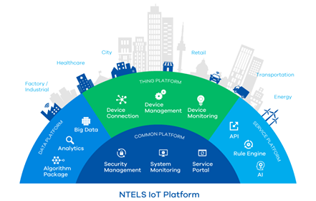
What does the IoT do?
Beyond the level of personal convenience, we can change our lives in general, from industrial units to public units such as smart cities that manage cities efficiently.
Reasons to note Above all, it is likely to be used in a variety of fields.

Slide 3
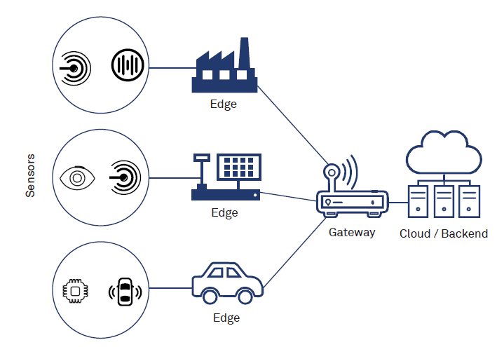
How does it perform its tasks?
Does it use online services?
Sensor - Ear Network - Neuron AI – Brain
An object with sensors receives information and communicates the results of its responses to the network, forming an intelligent and invisible network without human intervention through artificial intelligence AI using data.

Slide 4


Think about 'attack surface' and vulnerabilities.
The IoT attack surface is the sum total of all potential security vulnerabilities in IoT devices and associated software and infrastructure in a given network, be it local or the entire Internet.
software
sensor

Slide 5
Form of IoT security threats
Privacy infringement through CCTV In February 2016, about 73,000 CCTVs around the world were hacked and broadcast live on a site called InseCam.
Hacking of Smart Home Appliances Hackers hacked smart products from homes connected to the Internet and turned them into 'zombie appliances' and sent spam and phishing emails.
Safety threats from smart cars In July 2015, Fiat-Crankscrew recalled 1.4 million vehicles sold in the U.S. and is considered the first case in which an automaker conducted a recall due to exposure to hacking risks.

Slide 6
Therefore, IoT security is also an important topic that is emerging as IoT develops globally.

Slide 7
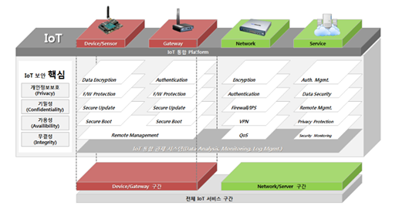

Slide 8
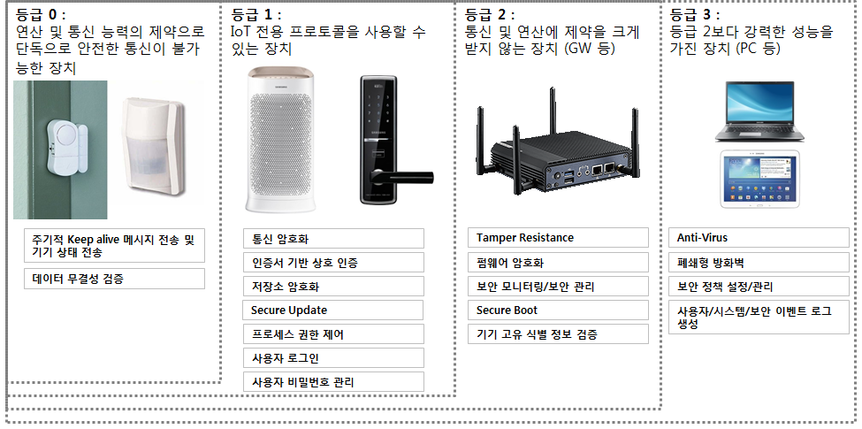
Devices that cannot communicate securely on their own due to lack of computational and communication skills. | Devices that can use IoT-specific protocols | Devices that are not heavily constrained by communications and operations | A device that has more power than Photo 2
1. Periodic instrument state transmission 2. Validation of data integrity | 1. Communications Encryption 2. Encrypting Storage 3. Control process permissions 4. Secure update | 1. Firmware Encryption 2. Secure boot 3. Validate instrument specific identification | 1. Security Required for Number 2. Anti-virus 3. Closed Firewall

Slide 9
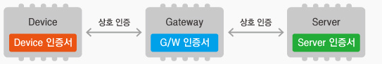
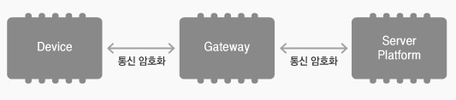
Are there internet ports that are available? (Can some software on the net connect to the technology?)
Mutual Authentication is a security technology that protects IoT products and servers from third parties by identifying the identity of the other party that carries out communication.
Encrypted Data Transfer is a secure technology that protects communication data from third parties by encrypting and transmitting data with session keys established through key exchange between the two performing the communication.

Slide 10
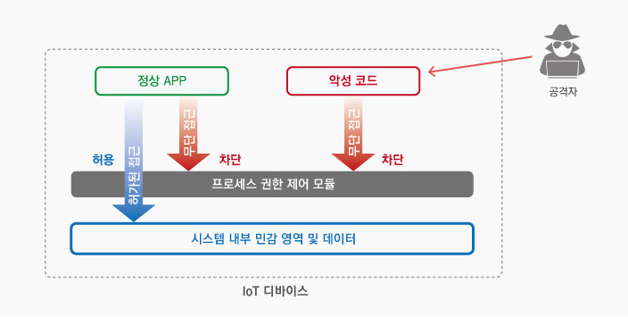
What safeguards are in place to prevent leaking information or unauthorized access?
The process authority control function controls the ability of processes running within a product to access memory, files, etc. to minimize the control of processes accessible to critical resources so that they cannot function normally even if malicious code is inserted.

Slide 11
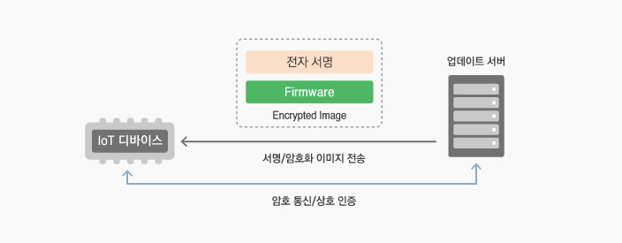
Are online software updates performed? What safeguards are there to assume an attacker can’t send a fake update with malware?
Secure Update is a technology to protect update firmware and is a security technology that performs mutual authentication between the update server and the product when performing updates, and prevents an update image from being captured through cryptographic communication and update image encryption, or the false update image from being installed on the product.

Slide 12
“IoT looks like technological advancements, but it should eventually become a tool to enrich and fatten human lives." -said Kevin Ashton

